Slide 1
Spring
Prepared by:
Pappu Rout

Slide 2
Agenda
1)Spring
2)DI/IOC
3) What Is Framework

Slide 3
Why Spring?
I wan to develop the high performance large scalable distributed enterprise application as J2EE architecture.
Suggest me best technology and frameworks for application.

Slide 4
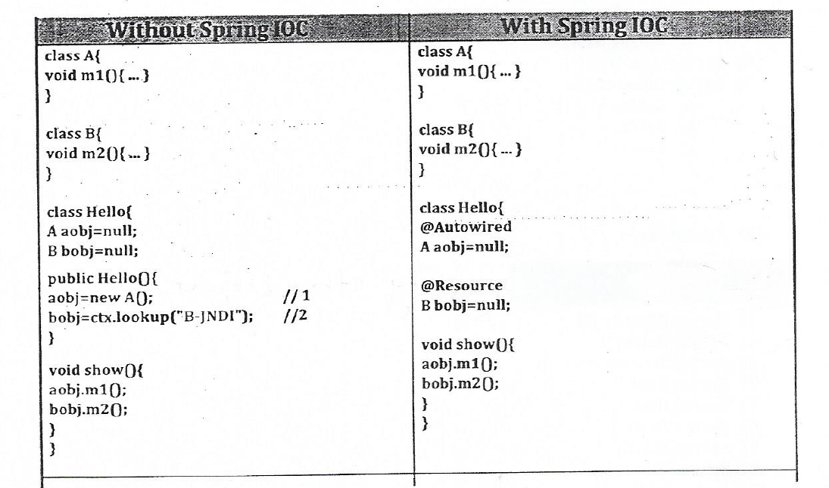
What is dependency Injection(IOC)

Slide 5
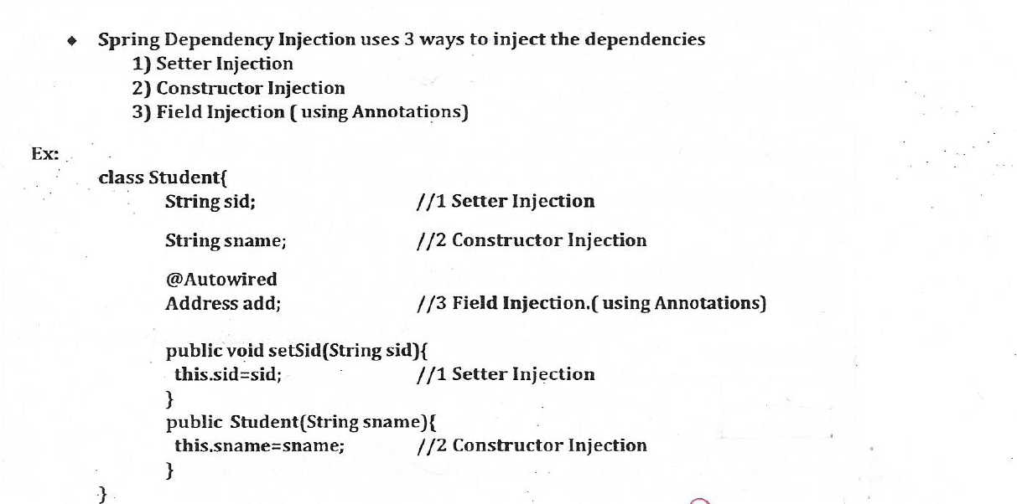
spring DI uses 3ways to inject the dependencies

Slide 6
Bean Scopes
1)Singleton
2)Prototype
3)Session
4)Request
5)Global Session

Slide 7
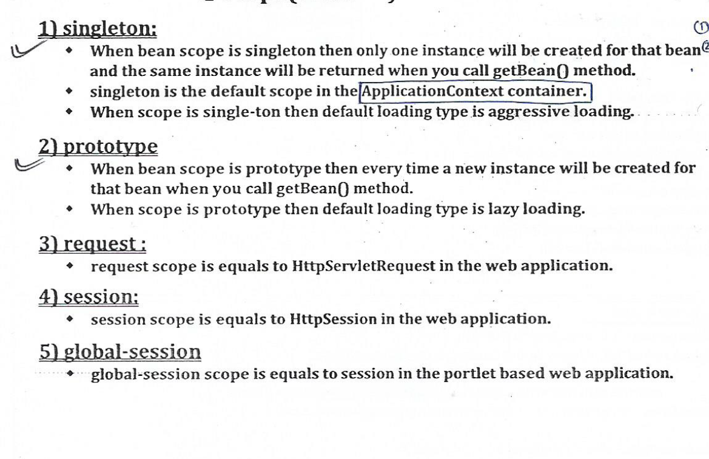
Bean Scopes

Slide 8
Bean Loading Type
1)Aggressive Loading or Eager Loading
2)Lazy loading

Slide 9
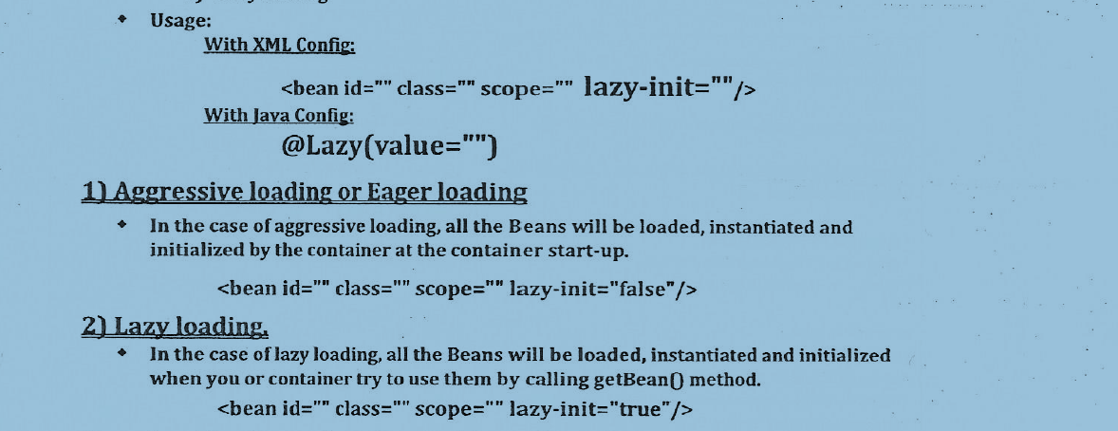
Bean Loading Type

Slide 10
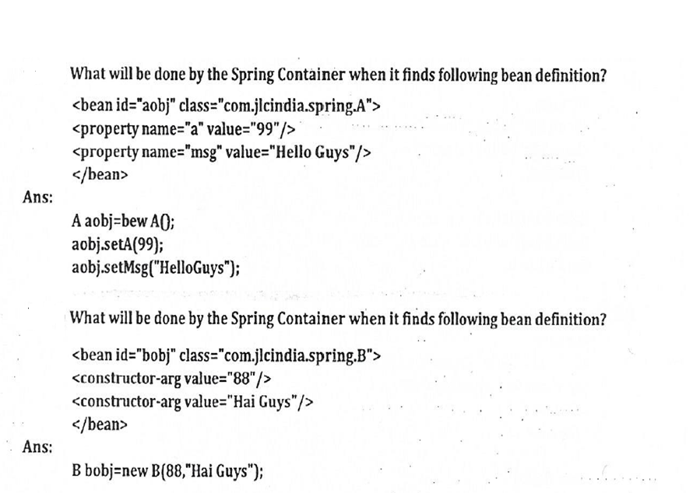
Cont…

Slide 11
What is Wiring?
Wiring is process of injecting dependencies of beans.
Wiring can be done by 2 ways.
1)Implicit wiring or Auto wiring
2)Explicit wiring

Slide 12
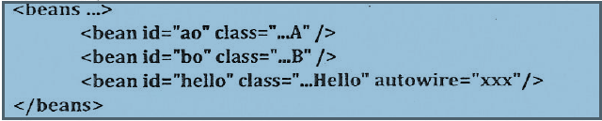
What is Implicit and Explicit wiring
Implicit- In case of Implicit/Auto wiring, spring container can detect bean dependencies automatically and inject those dependencies

Slide 13
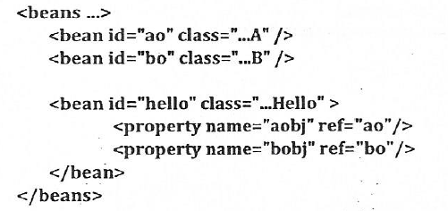
Explicit -> In case of Explicit wiring, you have to specify the bean dependencies than container will inject.

Slide 14
Values of Auto wiring attributes
1)ByName:
2)ByType
3)Constructor

Slide 15
byName
when autowire attribute value is byName then spring container checks whether any
bean instance running in the container whose name(or id) is same as bean property(variable) name or not.
when bean is found with the matching name then it will be injected otherwise bean property remains un-injected.
Bean will be Instantiated using Default constructor.
Dependent bean Instance will be detected using bean name.
Detected bean instance will be injected through setter injection only.

Slide 16
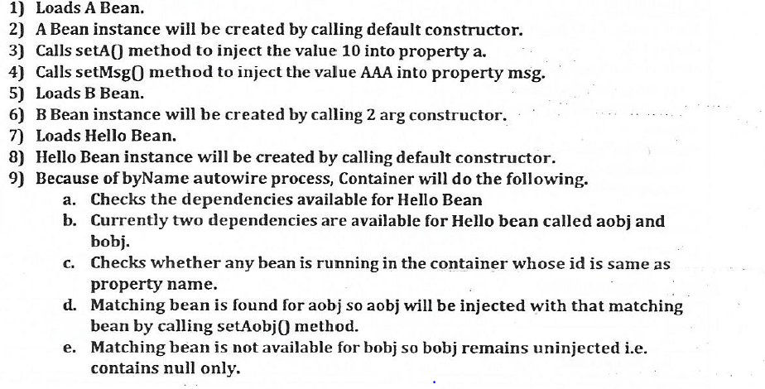
Cont….

Slide 17
byType
when autowire attribute value is byType then spring container checks whether any
bean instance running in the container whose type is same as bean property data type or not.
In This case you may get three cases.
a)when exactly one bean is found with the matching data type then it will be injected.
b)when no bean is found with matching data type then bean property will not be injected.

Slide 18
Cont..
c)When two or more beans is found with matching Data type then exception will be thrown called UnsatisfieldDependencyExceptiom
Error Message:
Unsatisfied dependency expressed through bean property 'a0bj': No unique
bean type[com.yas.className] is defined : expected single matching bean but 2[ao1, ao2]
d)Bean will be Instantiated using Defaule constructor.
e)Dependent bean Instance will be detected using bean data type.
Detected bean instance will be injetced through setter injection only.

Slide 19
Constructor
when autowire attribute value is constructor then spring container checks whether any
bean instance running in the container whose data type is same as bean property data type or not.
Dependency on the Availability of Bean instance, spring container Identifies the Matching constructor and invoke that constructor to inject the bean.

Slide 20
Constructor
In This case you may get three cases.
a)when no bean is found with matching data type then bean property will not be injected.
b)when exactly one bean is found with the matching data type and without matching constructor then bean property will not be injected.
c)when exactly one bean is found with the matching Data Type and with matching constructor then bean property will be injected.
d)When two or more beans are found with the matching Data type then
i)container will try to pick one bean from available multiple beans based on byname autowire process first.

Slide 21
Constrctor
ii)when one bean is not selected based on byName autowire process then ignores multiple beans found with given name.
e)Bean will be Instantiated using matching constructor.
f)Dependent bean Instance will be detected using bean data type.
g)Detected bean instance will be injected through constructor injection only.

Slide 22
Injected Subtypes into Super Types Reference
Can we do this?
Suppose Hello class id depend on A
B is sub class of a so can I inject B in Hello

Slide 23
Property Editors
PropertyEditors are used to edit the property values.
You can do the following using PropertyEditors.
a)Convert the value from one data type to another data type.
b)Convert the value from one data format to another data type.

Slide 24
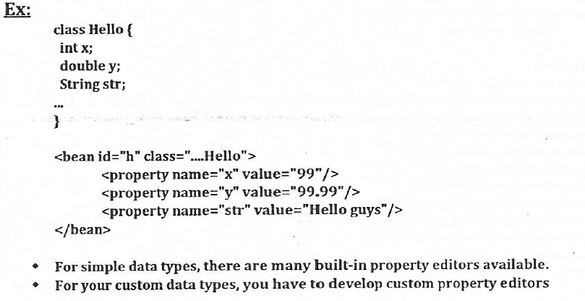
Property Editors

Slide 25
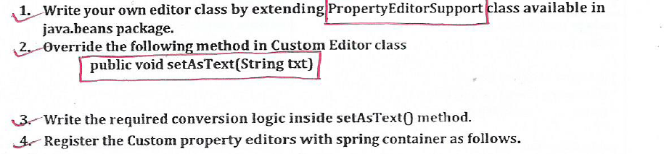
Steps to develop custom Property Editors

Slide 26
Steps to develop custom Property Editors
<bean class="org.springframework.bean.factory.config.CustomEditorConfigrer"?
<Property name="customeEdirtors">
<map>
<entry key="java.util.List" value= "com.yash.spring.ListEditor"/>
<entry key="com.yash.spring.Fee" value= "com.yash.spring.FeeEditor"/>
</map>
</property>
</bean>

Slide 27
AOP
when you are developing any enterprise application, you need the following services commonly:
1)Low Level Services.
2)Middle Level Services.
3)High Level Services.
Low Level Services
Some of the low level services are IO, Threading, Networking etc which will be supplied by servers freely.
2)Middle Level Services
Some of the Middle Level services are Transactions, Security, Logging, Messaging etc. which has to implemented by you.
3)High Level Services
High Level Services of Enterprise Application is nothing but Business Logic which you are writing for Business Operations.

Slide 28
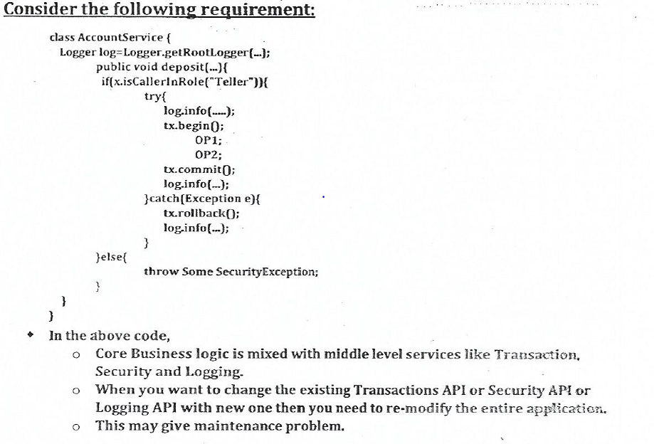
Without AOP

Slide 29
Spring AOP
AOP stand for Aspect Oriented Programming
AOP is new kind of programming technique which is mainly used to separates the common required middle level services logic from core business of the application.
Transaction, Security, Logging, Messaging etc. are the middle level services which are also called as cross-cutting concern.

Slide 30
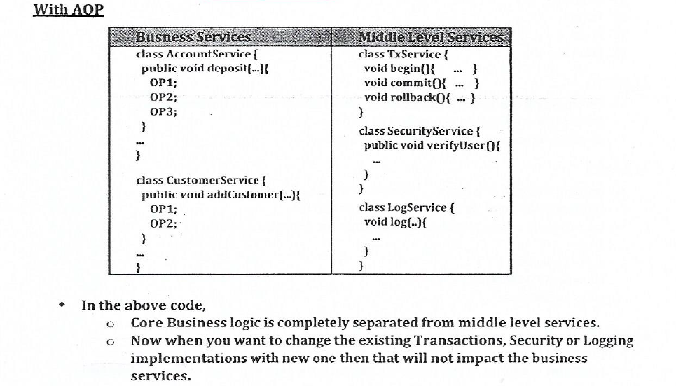
With AOP

Slide 31
Various AOP Framework
1)Spring AOP
2)AspectJ
3)Jboss AOP
Spring 2.0 AOP is integrated with AspectJ

Slide 32
Spring AOP Terminology
1)Aspect
2)Advice
3)JoinPoint
4)PointCut
5)Advisor
6)target
7)Proxy
8)Weaving

Slide 33
Aspect
Commonly Required Middle Level services which you are implemented for your Enterprise application are called as Aspect
Security, Transaction, Logging etc. are Aspect.

Slide 34
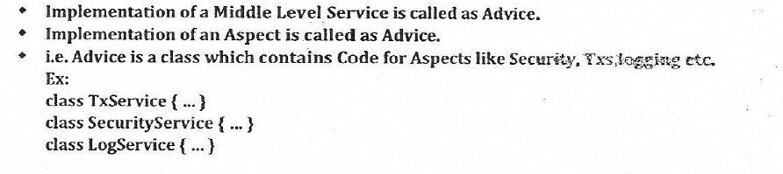
Advice

Slide 35
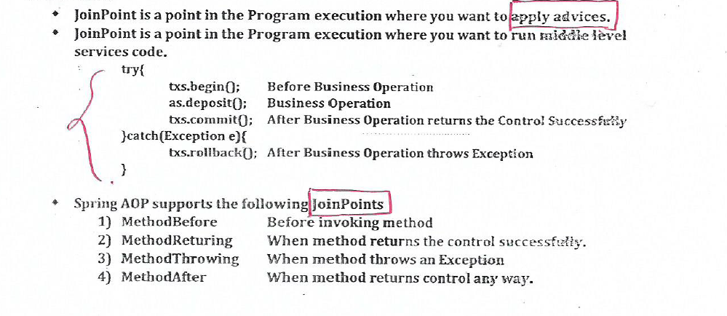
JointPoint

Slide 36
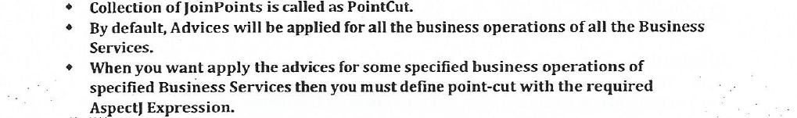
PointCut

Slide 37
Cont…
execution(* com.yash.spring.aop.*Service. *(..))
Advices will be applied for
a)getBal()of AccountService
b)myDeposite()of AccountService
c)myWithdraw()of AccountService
d)addCustomer()of CustomerService
e)updateCustomer()of CustomerService

Slide 38
Cont…
execution(* com.yash.spring.aop.AccountService. my*(..))
Advices will be applied for
a)myDeposite()of AccountService.
a)myWithdraw()of AccountService

Slide 39
Cont…
execution(* com.yash.spring.aop.CustomerService. update*(..))
Advices will be applied for
a)updateCustomer () of CustomerService

Slide 40
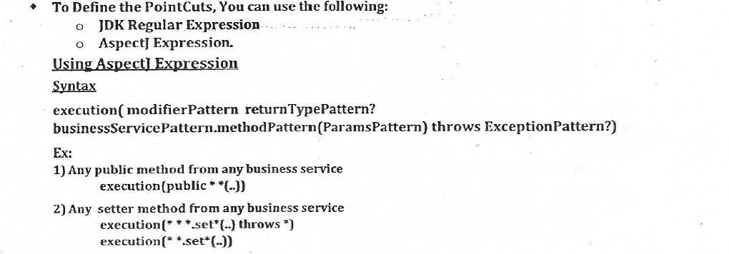
Define the pointcut

Slide 41
Define the pointcut
3)Any setter method form HelloService
execution(* com.yash.HelloService.set*(..))
4)any static methods starting with add from HelloService with return type Integer.
execution(*static int com.yash.HelloService.add*(..))
5)Any Method starting with add from service with ending service
execution(* *Service.add*(..))

Slide 42
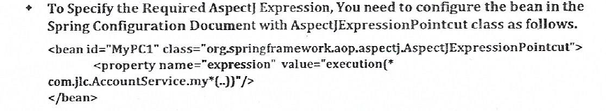
Cont..

Slide 43
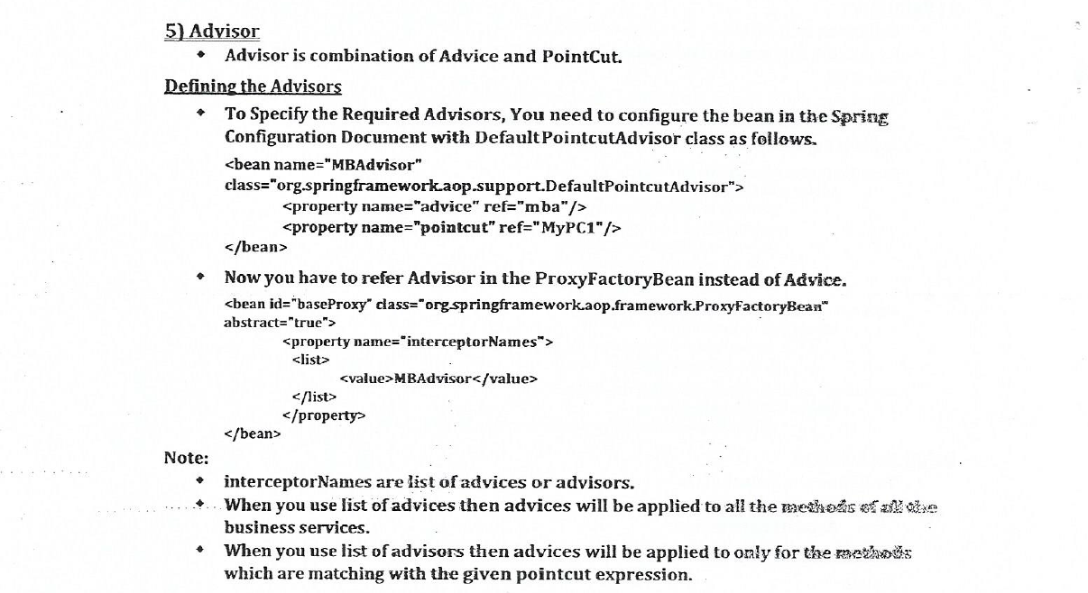
Advisor

Slide 44
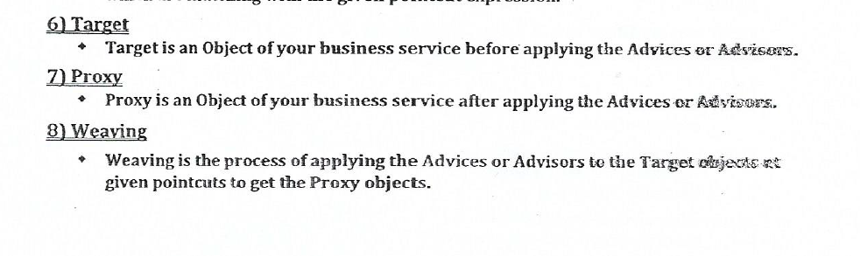
Cont..

Slide 45
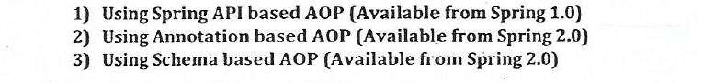
Spring provide 3 ways to implement AOP

Slide 46
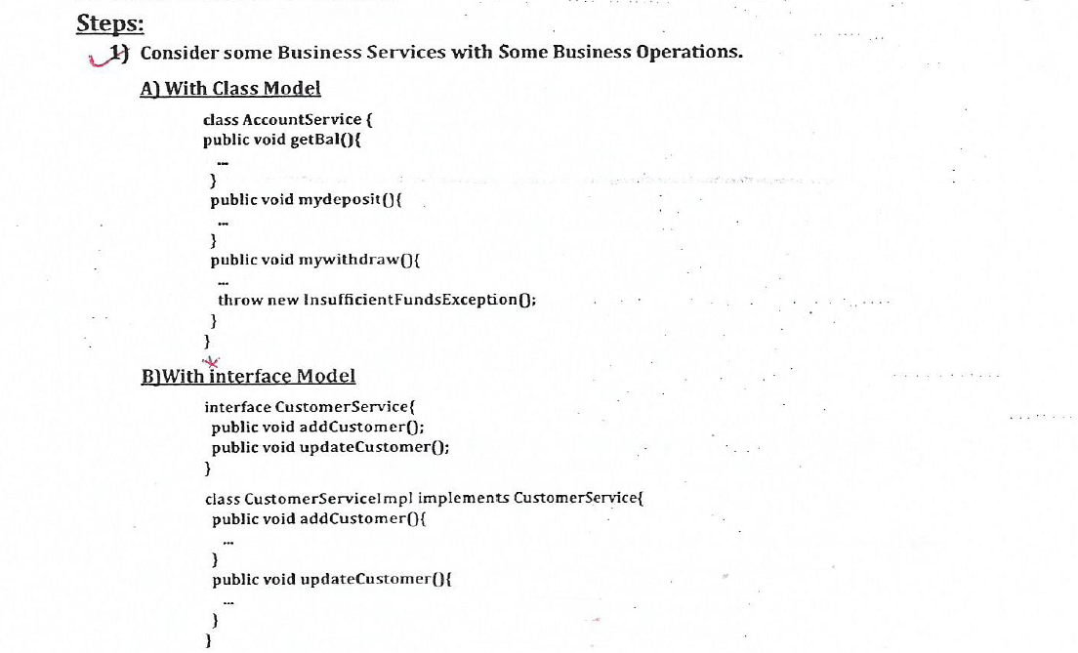
Using Spring API based AOP

Slide 47
Cont..
2)Configure these two business services beans in spring Configuration Document.
<bean id = "asTarget" class="com.yash.spring.aop.AccountService"/>
<bean id = "asTarget" class="com.yash.spring.aop.CustomerServiceImpl"/>
3)Identify the aspect or Middle Level services required for your Application.
I need Security, Transaction and Log Aspect.

Slide 48
Cont..
4)Write the Aspect classes for your Aspects or middle level services.
a)TransactionService.java
b)SecurityService.java
c)LogService.java
5)Configure these service bean in spring Configuration Document.
<bean id = "securityService" class="com.yash.spring.aop.SecurityService"/>
<bean id = "transactionService" class="com.yash.spring.aop.TransactionService"/>
<bean id = "logService" class="com.yash.spring.aop.LogService"/>

Slide 49
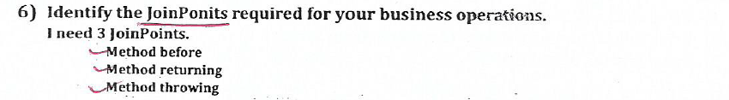
Cont..

Slide 50
Cont..
7)Write the required Advices classes as per the joinpoints required.
public class HelloMBAdvice implements MethodBeforeAdvise{
public void before(){
//verify user
//log into info
//begin Transaction
}
}

Slide 51
Cont..7
public class HelloMRAdvice implements AfterReturningAdvise{
public void afterReturning(){
//commit Transaction
//log into info
}
}

Slide 52
Cont..7
public class HelloMTAdvice implements ThrowsAdvise{
public void afterThrowing(){
//rollback Transaction
//log into info
}
}

Slide 53
Cont..
8)Configure these three Advices bean in spring Configuration Document.
<bean id = "mba" class="com.yash.spring.aop.HelloMBAdvice "/>
<bean id = "mra" class="com.yash.spring.aop.HelloMRAdvice "/>
<bean id = "mta" class="com.yash.spring.aop.HelloMTAdvice"/>

Slide 54
Cont..
9)Configure Proxy objects for your business services using ProxyfactoryBean
<bean id = "asProxy" class="org.springframework.aop.framework.ProxyFactoryBean">
<property name ="targetClass" class ="com.yash.spring.aop.AccountService"/>
<property name ="target" ref ="asTarget"/>
<property name ="interceptorNames">
<list>
<name>mba</name>
<name>mra</name>
<name>mta</name>
</list>
</property>
</bean>

Slide 55
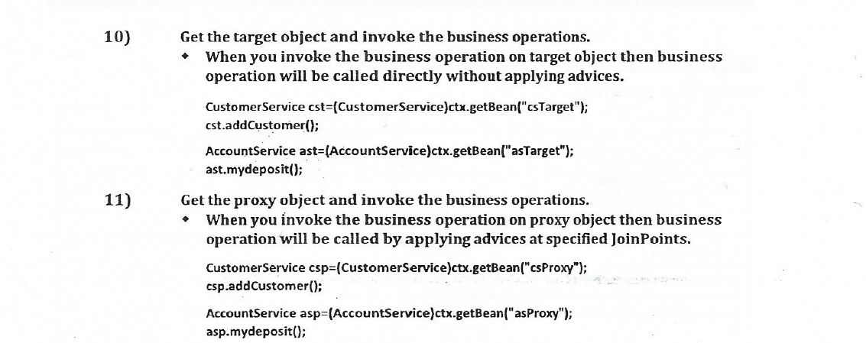
Cont..

Slide 56
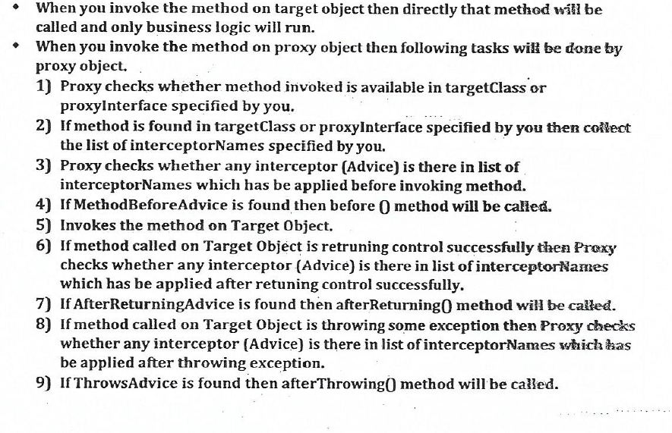
Flow of Execution

Slide 57
AOP Example Explanation-1
At Container start-up
A)Spring container scan and prepare the advices classes which are marked with @Aspect annotation.
B)Spring container scan and prepare the point-cut expression specified inside the advices classes.
C)Spring container scan and prepare the methods which are referring point-cut specific special method.
D)Spring container scan and prepare the methods which are marked with Join-point related Annotation(@Before, @AfterThrowing…)

Slide 58
AOP Example Explanation
When you invokes any business operation:
A)Takes the method invoked by you and check whether that method is matching with any of point-cut Expression specified.
B)When method is not matching with any of point-cut Expression given then that method will be called directly without applying any advices.
C)When method is matching with any of point-cut Expression given then specified advices will be apply for that method

Slide 59
@Around
When you specifying @Around for any method then:
A)That method has to take ProceedingJoinPoint as parameter.
With ProceedingJoinPoint, you have to call proceed() method to invoke the business operation.

Slide 60
Example
@Around, @AfterThrowing, @After
Pointcuts based on annotation with @pointcut
Autoprocying

Slide 61
Thank You

